Slide 1
Infrastructure Spinner
Introduction To Database Systems
Ammar Khan
17010020010
BSCS-10

Slide 2
Project Description
The project is aimed to provide a divergent approach to traditional Virtual Machine deployment methodology, which provides an automated backend to users/admins needs in these ways.
Database solution ,running as a back bone of the infrastructure, not only keeps record of existing hardware resources and users credentials/resources requests , but it will also be used to invoke/revoke Virtual Machines based on users actions. It strikes down the traditional file based approach used by system administrators ,which fails for large scale diverse systems.
A python based front-end application is used to communicate to database for infrastructure deployments. The library used to communicate to database server is Psycopg2.

Slide 3
Continue….
Database system used is PostgreSQL which follows Object-Based-Relational database model to further tightly couple the database system with a high-level programming language.
A back-end python application will look for changes in database systems due to users requests and will take desired actions.
No user will be talking to database system directly. Users/admins will talk to provided application and each application will be communicating with the server using a Role to tighten the security.

Slide 4
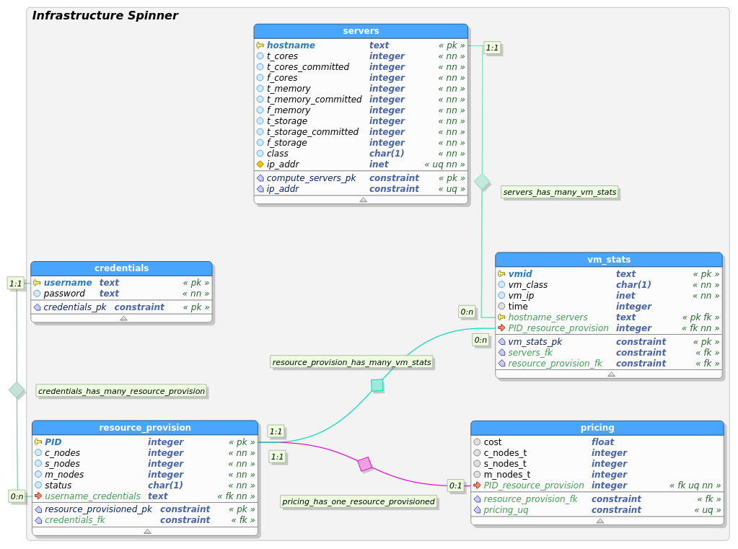
ERD
Database can only be manipulated by following roles.
db_admin
db_cred
db_prov
db_cal
vb_vm

Slide 5
Roles Explained
All roles are application based users that will be used to talk to database indirectly.
db_admin is the owner of database system , has complete access to all aspects of database “Infrastructure_Spinner”;
db_cred is a role used by frond-end python program to register/login users on “credentials” table.
db_prov is a role used by front-end python program to provision/track/revoke resources requests on “resource_provision” table.
db_vm is a role used by back-end python program that will populate resources provisioned by the servers on “vm_stat” table.
db_admin is the major role that will populate actual hardware servers in its possession and will report its resources used/available on “servers” table.
db_cred is the role that will populate costs for each virtual resource provisioned in “pricing” table.

Slide 6
Provisioning Explained
Python program associated with each server will populate the hardware resources using db_admin.
It will also be looking for provisioning/decommissioning requests from “resource_provision” table and will perform KVM(Hypervisor) actions to deploy/remove Virtual Resources.
Each Virtual Resource that has been provisioned will be tracked in “vm_stat” table individually including the runtime.

